Slide 1
ListBox
The ListBox control allows the user to view and select from multiple items in a list.
ListBox is a static GUI entity, which means that users cannot directly edit the list of items Properties
Items: collection of items in the ListBox
MultipleItems: indicates whether the listbox can display multiple columns.
SelectedIndex: returns the index of the selected item.
Sorted: sorts the items in the listbox alphabetically.
SelectedIndexChanged(Event): Generated when the selected index changes. This is the default event when the control is double clicked in the designer.

Slide 2
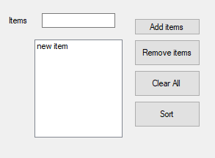
Demo
This is a demo app that has a list box and four buttons for adding, removing, clearing and sorting listbox items.

Slide 3
Cont
private void add_btn_Click(object sender, EventArgs e)
{ listBox1.Items.Add(textBox1.Text);
private void remove_btn_Click(object sender, EventArgs e)
{ listBox1.Items.RemoveAt(listBox1.SelectedIndex); }
private void clearall_btn_Click(object sender, EventArgs e)
{listBox1.Items.Clear(); }

Slide 4
CheckedListBox
The CheckedListBox control derives from ListBox and displays a CheckBox with each item.
Items can be added via methods Add and AddRange or through the String Collection Editor(similar to ComboBox, ListBox).
CheckedListBoxes allow multiple items to be checked, but item selection is more restrictive.
Selection Mode: One or none effectively switches between enabling and disabling the user’s ability to check list items.

Slide 5
Common Properties and Events
CheckedItems: Accessible only at runtime. Returns the collection of items that are checked as a CheckedListBox.CheckedItemCollection.
CheckedIndices: Accessible only at runtime. Returns indices for all checked items as a CheckedListBox.CheckedIndexCollection.
Methods
GetItemChecked(): takes an index and returns true, if the corresponding I
Events
ItemCheck: generated when an item is checked.

Slide 6
ItemCheckEventArgs Properties
CurrentValue: indicates whether the current item is checked or unchecked. Possible values are checked, unchecked and indeterminate.
Index: returns returns the zero based index of item that changed.
NewValue: specifies the new state of the item.

Slide 7
Demo
The following example uses a CheckedListBox and a ListBox to display a user’s selection of books.
The CheckedListBox named inputCheckedListBox allows the user to select multiple titles.
Using String Collection Editor add the following items:
C++, Java, VB, Internet & WWW, Perl, Python, Wireless Internet and Advanced Java.
The ListBox, named displayListBox – displays the user’s selection.
In the screen shots accompanying this example, the CheckedListBox appears to the left, the ListBox to the right.

Slide 8
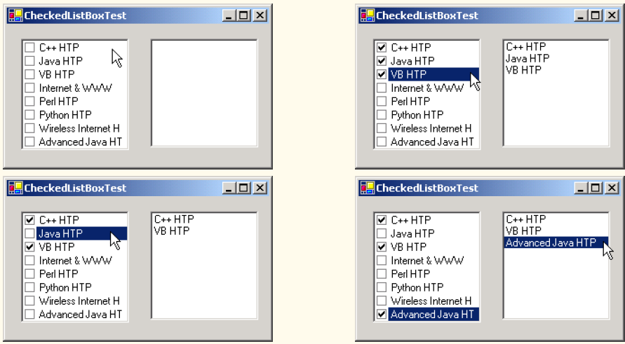

Slide 9
How does it work?
When the user checks or unchecks an item in CheckedListBox inputCheckedListBox, the system generates an ItemCheck event.
Event handler inputCheckedListBox_ItemCheck handles the event.
An if/else control structure determines whether the user checked or unchecked an item in the CheckedListBox.
The program uses the NewValue property to test for whether the item is being checked (CheckState.Checked).
If the user checks an item, adds the checked entry to the ListBox displayListBox.
If the user unchecks an item, line 41 removes the corresponding item from displayListBox.

Slide 10
Cont
// item about to change, add or remove from displayListBox
private void inputCheckedListBox_ItemCheck( object sender, System.Windows.Forms.ItemCheckEventArgs e )
{
// obtain reference of selected item
string item = inputCheckedListBox.SelectedItem.ToString();
// if item checked add to listbox otherwise remove from listbox
if ( e.NewValue == CheckState.Checked )
displayListBox.Items.Add( item );
else
displayListBox.Items.Remove( item );
}

Slide 11
Tab
The TabControl control creates tabbed windows, such as those we have seen in the Visual Studio .
This allows the programmer to design user interfaces that fit a large number of controls or a large amount of data without using up valuable screen “real estate.”
TabControls contain TabPage objects, which are similar to Panels and GroupBoxes in that TabPages also can contain controls.

Slide 12
Cont.
The programmer first adds controls to the TabPage objects, then adds the TabPages to the TabControl.
Only one TabPage is displayed at a time. Figure 13.26 depicts a sample TabControl.
Programmers can add TabControls visually by dragging and dropping them onto a form in design mode.
To add TabPages in the Visual Studio .NET designer, right-click the TabControl, and select Add Tab
Alternatively, click the TabPages collection in the Properties window, and add tabs in the dialog that appears.

Slide 13
Cont.
Note that clicking the tabs selects the TabControl—to select the TabPage, click the control area underneath the tabs.
The developer can add controls to the TabPage by dragging and dropping items from the ToolBox.
To view different TabPages, click the appropriate tab (in either design or run mode).

Slide 14
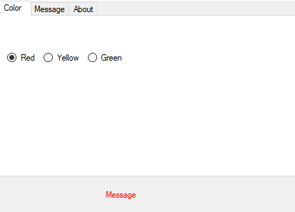
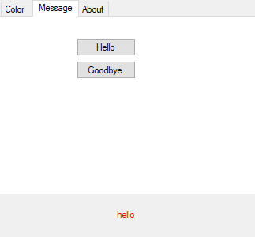
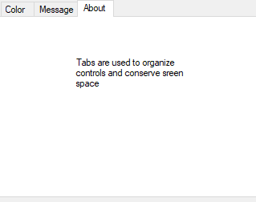
Demo

Slide 15
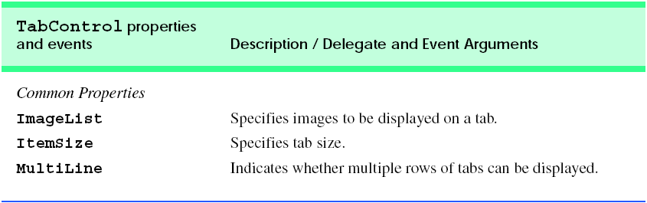
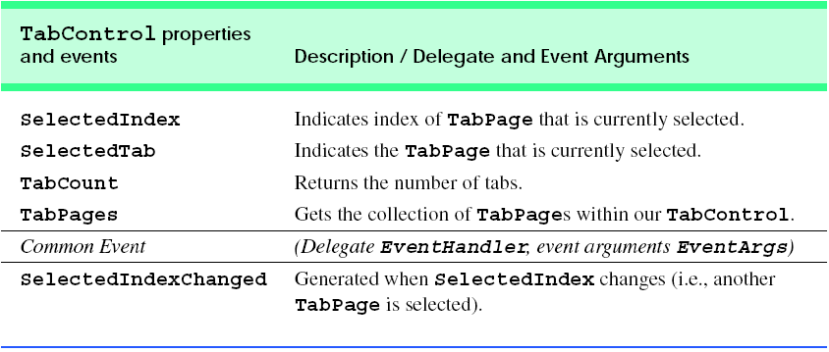

Slide 16
Mouse EventHandling

Slide 17
Mouse events
Mouse events are generated when the user interacts with a control via the mouse.
Mouse events can be handled for any control that derives from class System.Windows.Forms.Control. For most mouse events, information about the event is passed to the event-handling method through an object of class MouseEventArgs.
The delegate used to create the mouseevent handlers is MouseEventHandler.

Slide 18
Mouse Events and EventArgs
Mouse Events with Event arguments of EventArgs
MouseEnter: mouse cursor enters the control’s boundaries
MouseHover: mouse cursor hovers within the control’s boundaries
MouseLeave: mouse leaves the control’s boundaries.
Mouse events with Event Arguments of MouseEventArgs
MouseDown:mouse button is pressed within the boundaries of the control
MouseMove:mouse cursor is moved within the boundaries of the control
Mouse button is pressed while the mouse cursor is within a control’s boundaries.

Slide 19
Cont.
MouseUp: mouse button is released when the cursor is over the control’s boundaries
MouseEventArgs Properties
Button: specifies which button is pressed(Left, Right,Middle,None)
Clicks: the number of times the mouse is clicked
X: the x-coordinate within the control where the event occurred
Y: the y-coordinate within the control where the event occurred.

Slide 20
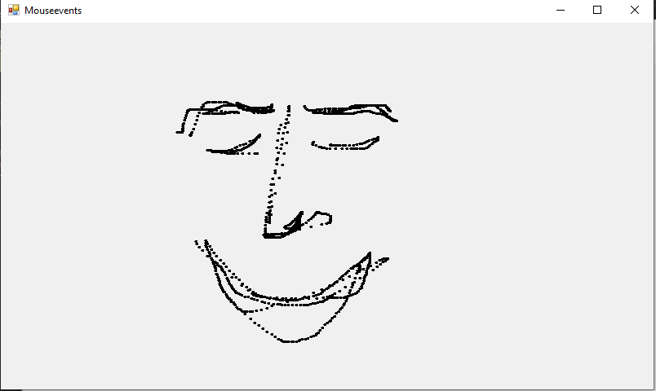
Demo: PaintApp

Slide 21
Code
public partial class Mouseevents : Form
{
bool shouldpaint = false;//whether to paint or not
public Mouseevents()
{ InitializeComponent(); }
private void Mouseevents_MouseDown(object sender, MouseEventArgs e)
{ shouldpaint = true; }

Slide 22
Cont.
private void Mouseevents_MouseUp(object sender, MouseEventArgs e) { shouldpaint = false; }
private void Mouseevents_MouseMove(object sender, MouseEventArgs e)
{ if(shouldpaint)
{
using (Graphics graphics = CreateGraphics())
{
graphics.FillEllipse(new SolidBrush(Color.Black), e.X, e.Y, 4, 4);
} }
}

Slide 23
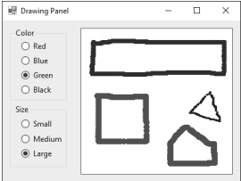
Exercise(Due December 2)
(Enhanced Painter) Extend the program of Fig. 14.38 to include options for changing the size and color of the lines drawn. Create a GUI similar to Figure below The user should be able to draw on the app’s Panel. To retrieve a Graphics object for drawing, call method panelName.CreateGraphics(), substituting in the name of your Panel.

